Slide 1

JS in browser, DOM
Unit 16

Slide 2
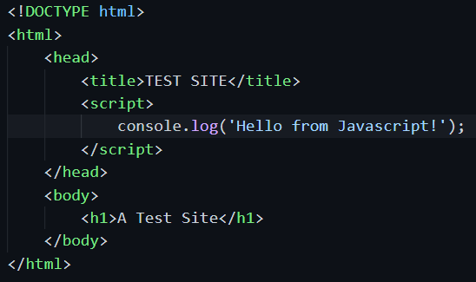
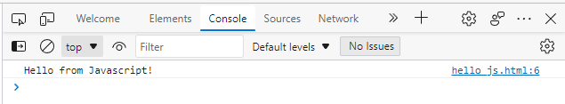
JavaScript in browser
Website will send back HTML file to browser upon request.
Javascript can be embedded inside the html file.
Or, as separated .js file, with a link inside the html file. Browser will fetch the .js file upon parsing the html.

Slide 3

dom
Document Object Model : The way a document content is accessed and modified.
The objects are organized in a hierarchy. This hierarchical structure applies to the organization of objects in a web document.
We can locate any HTML element within any HTML document using HTML DOM.

Slide 4
Loading process
Here is a general load process and related events.
Load HTML, script
Load CSS
Load img
Load other static resource
DOM ready, fire event
Finish page load, fire event
DOMContentLoaded
load

Slide 5
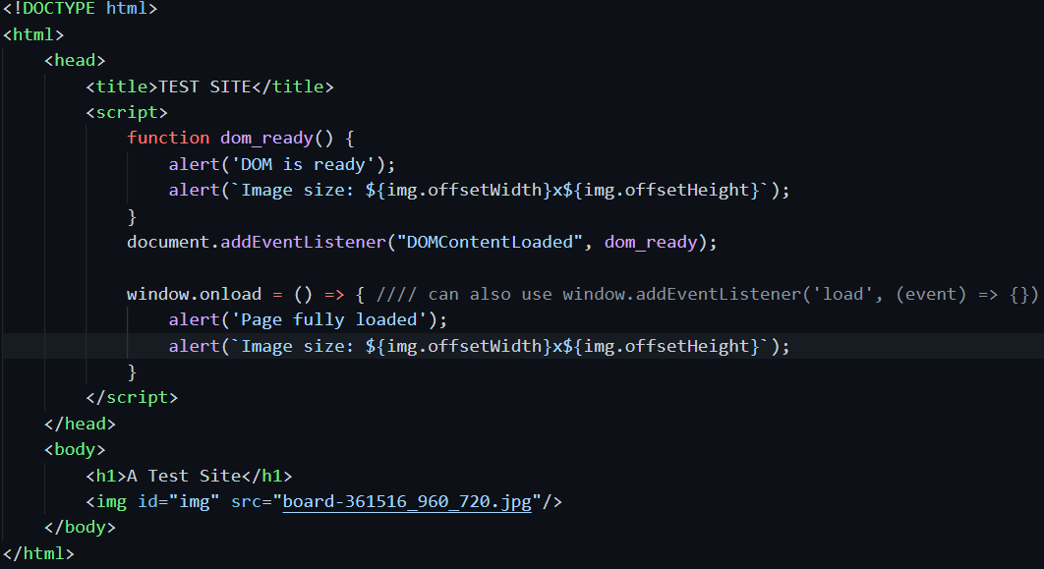
Add event listener

Slide 6
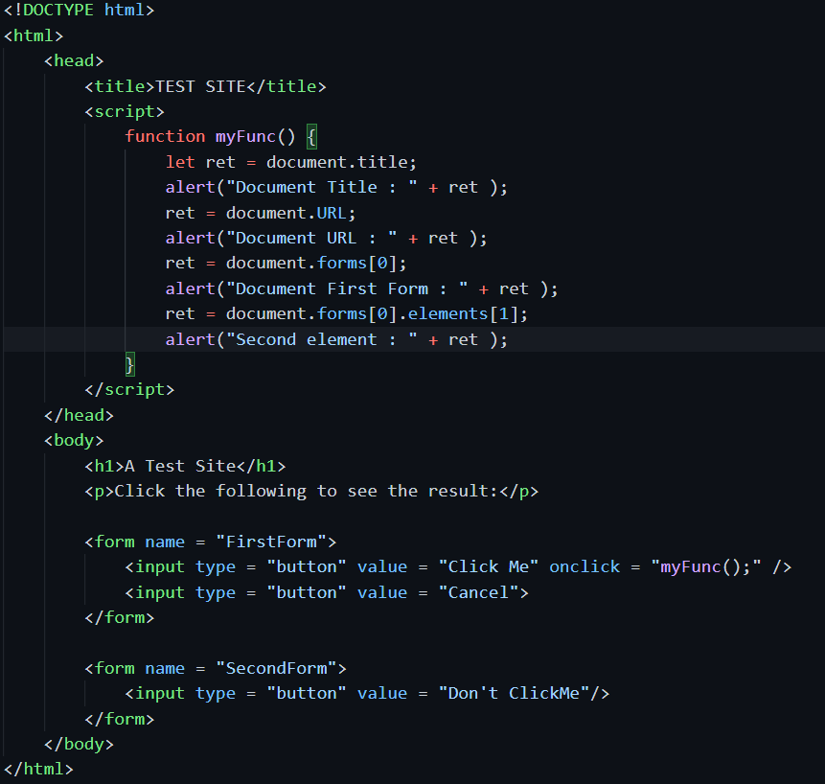
interaction

Slide 7
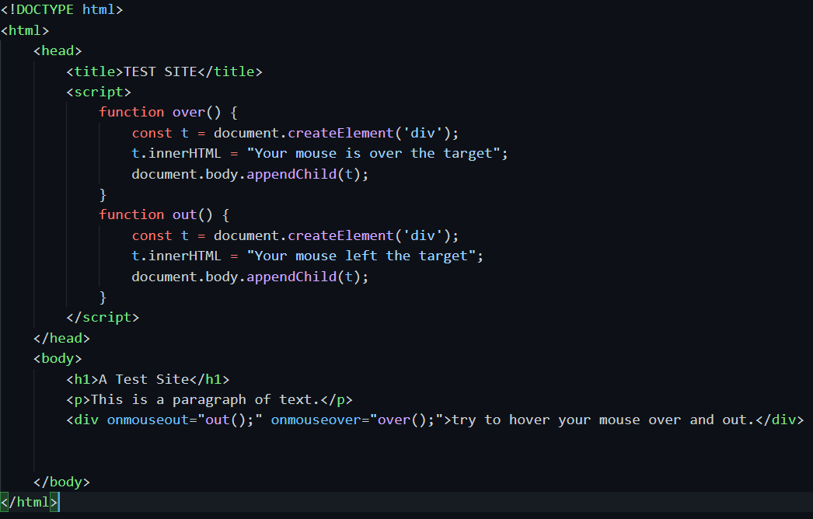
interaction

Slide 8
to manipulate DOM
GetElementById, GetElementByName, GetElementByTagName, etc.
innerHTML property is the text of the element. Can get and set the value.
style property is the style of the element. Can get and set value.

